Slide 1
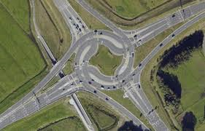
TCA cycle
Thusitha Wickramasinghe BSc PhD
Dept. of Biochemistry and Clinical Chemistry
05/01/2018 Batch 28

Slide 2
Objectives
At the end of this lecture students should be able to,
Explain the structure, function and regulation of pyruvate dehydrogenase complex (PDH)
Outline the sequence of reactions and regulation of TCA cycle
List vitamins and cofactors that are required by TCA enzymes
Describe central role of TCA cycle in carbohydrates, amino acids, and fat metabolism
Describe the clinical implications of inherited enzyme deficiencies and effect of inhibitors of TCA

Slide 3
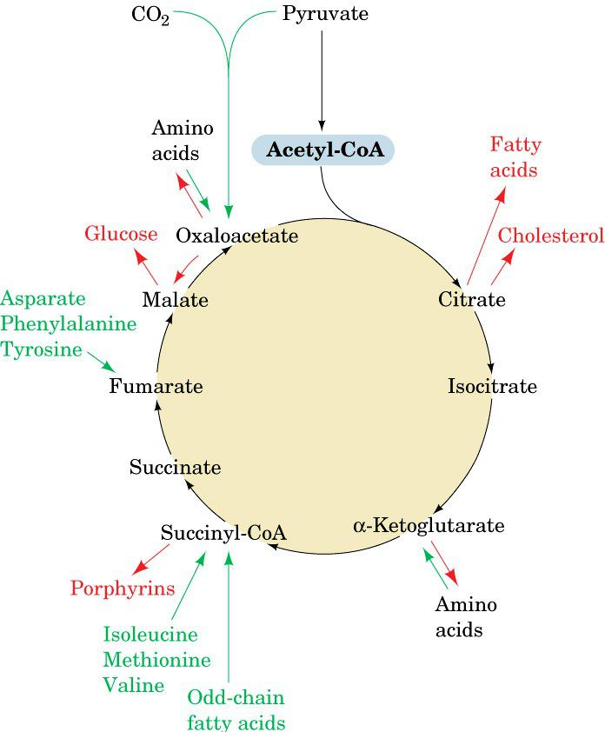
TCA cycle: Central role in metabolism
Amphibolic nature
Transamination
Deamination
Fatty acid oxidation
Gluconeogenesis
Fatty acid synthesis
Porphyrin synthesis

Slide 4
Location of TCA
Outer membrane – most small molecules can freely diffuse across- Permeable to Pyruvate
Inner membrane – pyruvate is transported across using carrier molecule
Notes:
Intermembrane Space: space between inner and outer membrane
Inner Membrane: high ratio of proteins to lipids-most molecules must pass through protein channels
Cristae: internal compartments formed by the inner membrane
Matrix: space inside inner membrane

Slide 5
Acetyl CoA input and CO₂ production
pyruvate
Amino acids
Fatty acids
Acetyl-CoA
(2C)
(6C)
Citrate
Oxaloacetate
Isocitrate
(6C)
(4C)
CO₂
Malate
(4C)
α-Ketoglutarate
(5C)
Fumarate
CO₂
(4C)
Succinyl-CoA
(4C)
Succinate
(4C)

Slide 6
Glycolysis → TCA cycle
CoA
NAD+
NADH
pyruvate
Acetyl-CoA + CO₂
PDH complex
(TPP, Lipoate, FAD)
Main regulatory point of TCA (especially when carbohydrates are the primary energy source)
oxidative decarboxylation

Slide 7
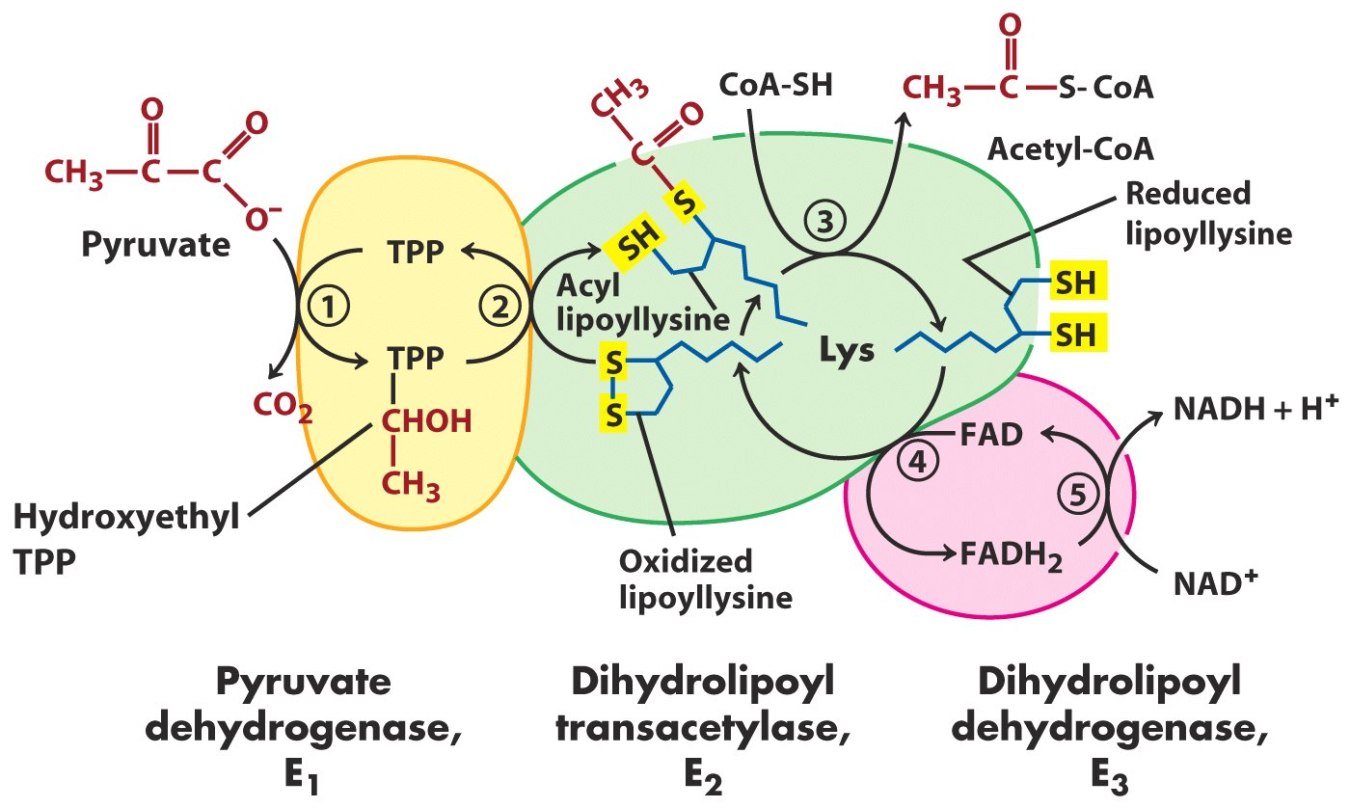
Pyruvate dehydrogenase Complex (PDH)
CoA :substrate
NAD⁺ as substrate

Slide 8
PDH complex
non covalently associated group of Enzymes that catalyze sequential steps in a metabolic pathway
CoA [Pantothenic Acid B5] and NAD [Niacin: B5]

Slide 9
Advantages of multi En complex?
Higher rates of reaction
product of one enzyme acts as a substrate of other, and is available for the active site of next enzyme without diffusion
Minimize side reactions
Coordinated control
Notes:
Central to metabolism, it is a cycle

Slide 10
Regulation of rate of reactions
allosteric
hormonal
gene exp.
A
A
A
Hormone 1-activates Enz
B
B
B
[Enz]
C
C
C
Enz
Enz
Enz
D
D
D
Enz
[Enz]
E
E
E
Hormone 2-inactivates Enz

Slide 11
Regulation of PDH complex
End product inhibition
NADH and Acetyl-CoA inhibit PDH
Covalent modification
PDH kinase activated in high energy state-lowering PDH activity
Calcium is an important activator of PDH in muscles
Notes:
Ca²⁺:important secondary messenger- enhances phosphatase activity.

Slide 12
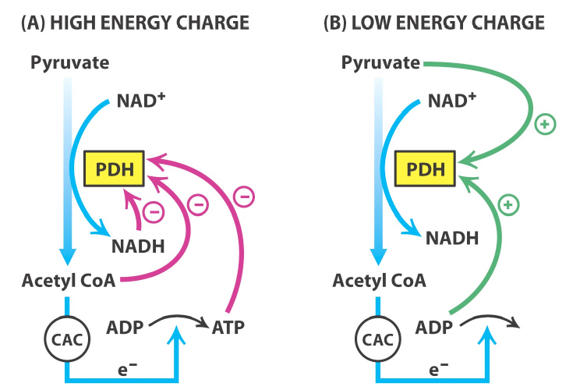
Regulation of PDH complex

Slide 13
TCA cycle-energy generation
pyruvate
Amino acids
Fatty acids
Oxygen dependent
Net synthesis
6 NADH
2 FADH₂
2 GTP (~ATP) by substrate level phosphorylation
Acetyl-CoA
Citrate
Oxaloacetate
Isocitrate
NADH
CO₂
Malate
α-Ketoglutarate
Fumarate
CO₂
Succinyl-CoA
FADH₂
Succinate
GDP/ADP
FAD
GTP/ATP

Slide 14
Regulation of the TCA
The TCA cycle is tightly regulated at multiple points
Energy status of the cell
NADH/NAD+ and ATP/ADP
Therefore respiratory control via the respiratory chain and oxidative phosphorylation primarily regulates TCA cycle
Rate of flux through TCA cycle is affected
Substrate availability
Product inhibition
Allosteric feedback inhibition
Potential sites of regulation
irreversible steps in the cycle
Notes:
Each can become a rate limiting step under certain circumstances. When acetyl CoA and OA are available or not , citrate formation increase or decrease.
NADH increases (a product of the oxidation of isocitrate and α -KG) , NADH/[NAD] increases, those dehydrogenase reactions are severely inhibited

Slide 15
Key regulatory points within TCA
Citrate synthase
Isocitrate dehydrogenase
α-Ketoglutarate dehydrogenase
Acetyl-CoA
NADH, Succinyl CoA, Citrate, ATP
ADP
Citrate
1
Oxaloacetate
Isocitrate
ATP, NADH
2
Ca²⁺,ADP
Malate
α -Ketoglutarate
3
Succinyl-CoA, NADH
Fumarate
Ca²⁺
Succinyl-CoA
Succinate

Slide 16
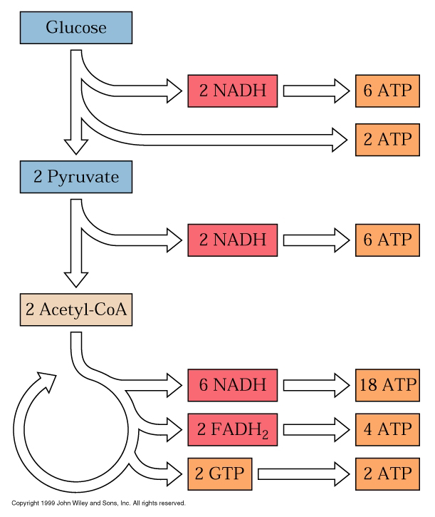
A single molecule of glucose can potentially yield ~38 molecules of ATP

Slide 17
Anabolic role of TCA cycle
All the intermediates of the cycle are potentially glucogenic [via oxaloacetate]
Oxaloacetate +GTP PEP+ GDP+CO₂
Excess carbohydrates can be converted in to fat and non essential AA [transamination reactions: AST, ALT] and Fat
Excess proteins can be converted in to carbohydrates and Fat
Haeme biosynthesis:
[Succinyl CoA + Glycine porphyrins]
PEP carboxykinase

Slide 18
Anaplerotic reactions
Anaplerosis is the act of replenishing TCA cycle intermediates
Oxaloacetate from pyruvate by Pyruvate carboxylase (PC)
Malate from pyruvate by Malic enzyme
Transamination reactions
oxaloacetate from Aspartate
α- ketoglutarate from Glutamate dehydrogenase
Formation of Succinyl CoA –from the oxidation of odd chain fatty acids

Slide 19
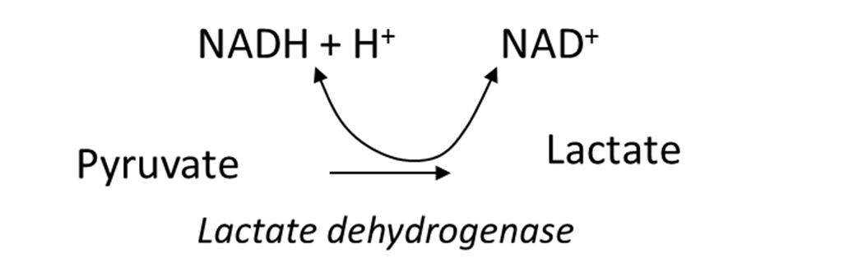
PDH deficiencies
Inherited PDH deficiency
Rare
Pyruvate accumulation
Lactic acidosis
CNS primarily depends on Glucose metabolism, brain get easily affected
variety of neurological problems
Similar symptoms with vitamin deficiencies that affect PDH complex
Beriberi : Vitamin B₁ (thiamine)
X
PDH
Acetyl CoA

Slide 20
Arsenic/heavy metal poisoning
(Lipoic acid –Part of PDH complex)
Hg, Ar, and Pb have high affinity for –SH
Inhibit PDH activity

Slide 21
Summary of TCA
TCA is the metabolic hub of the cell
It converts Acetyl CoA into ATP/GTP, NADH and FADH₂
Carbon dioxide is released in this process
Various intermediates of the cycle are connected to other important anabolic pathways (lipid, glucose, cholesterol and porphyrin synthesis)
Primary regulation is via PDH (acetyl CoA entry)
Cycle is activated under low energy charge and slowed down when energy state of the cell is improved
PDH deficiency or inhibition results with lactic acidosis and/or neurological problems

Slide 22
